Slide 1
WELCOME
DATE:- 03/12/2022

Slide 2
TODAY’S TOPIC
Sorting
Searching
Pointer
Call by Reference
Pointer to an array

Slide 3
SORTING
Sorting is the process of arranging elements either in ascending (or) descending order.
SORTING
INTERNAL SORTING
EXTERNAL SORTING
BUBBLE SORT
INSERTION SORT
SELECTION SORT

Slide 4
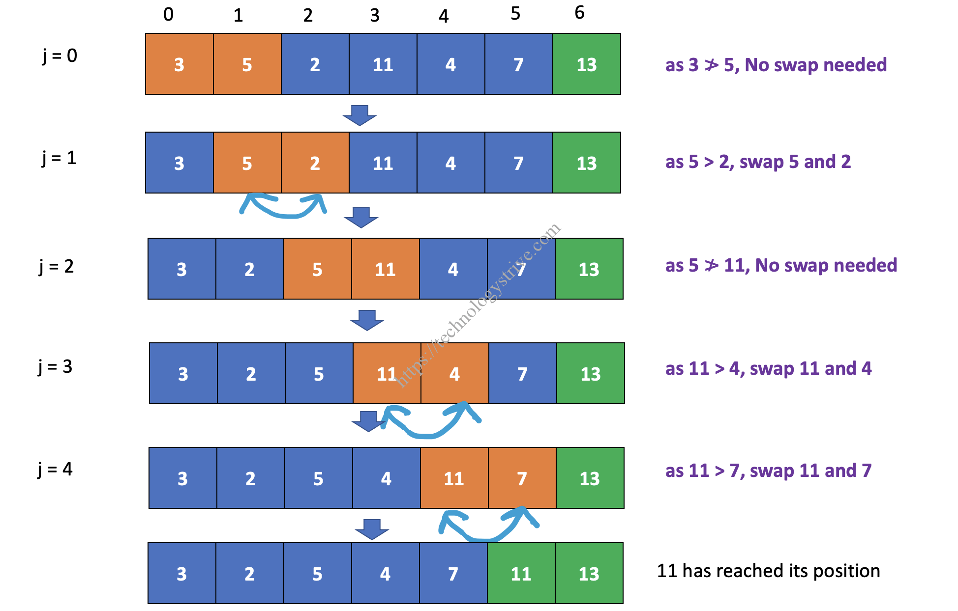
BUBBLE SORT
Bubble sort algorithm starts by comparing the first two elements of an array and swapping if necessary,

Slide 5
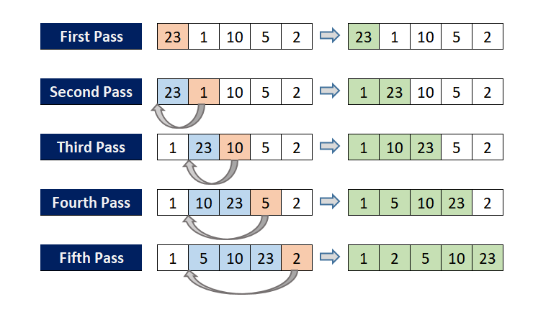
INSERTION SORT
Insertion sort is a simple sorting algorithm that builds the final sorted array (or list) one item at a time by comparisons.

Slide 6
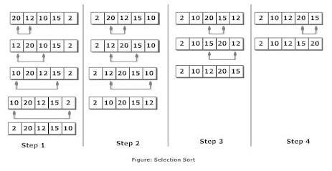
SELECTION SORT
the smallest value among the unsorted elements of the array is selected in every pass and inserted to its appropriate position into the array.

Slide 7
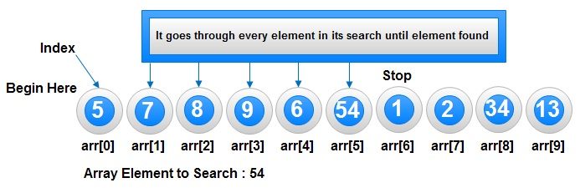
SEARCHING TEACHNIQUE
LINEAR SEARCH
BINARY SEARCH
LINEAR SEARCH :-

Slide 8
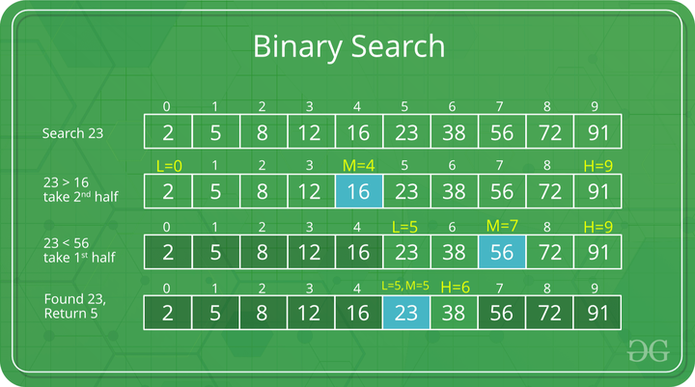
BINARY SEARCH :-

Slide 9
POINTER
A pointer is a variable that stores the memory address of another variable as its value.
SYNTAX :-
type *var-name;
CALL BY REFERENCE
The call by reference method of passing arguments to a function copies the address of an argument into the formal parameter.
SYNTAX :-
{
swap(&a, &b);
}
Type udf(*a,*b)
{}

Slide 10
POINTER TO AN ARRAY
Pointers are variables which stores the address of another variable. When we allocate memory to a variable, pointer points to the address of the variable.
SYNTAX :-
datatype *variable_name[size];

Slide 11
THANK YOU

